Slide 1
United Way Presentation

Slide 2
Objective
Reproduce what Vincent had done in his excel sheet in R, so United way could build a model with Forio.com

Slide 3
Methods
Create a workable way to calculating the old Child Wellbeing Index, so we can integrate in Forio and create a visual model:
Calculate Mean and Population Deviation
Core Algorithm: Do Z-Score
Adjust it so that it is only between -3.1 and 3.1 Add the z-scores in order in listed order and divide by the amounts
Turn things that should be negative to actual negative
Calculate the Child, Family, and Community Sub-Index
CWI = Average the 3 sub indices
Rescale them from 1-100
Quintiles calculated

Slide 4
methods
Plots
We then created box plots, histograms, and quintiles of the Z-scores, and Indexs as we will show in our results.
We found that box plots really don’t work
Because 4 segments and quintiles are for 5
Because visually the lower end of the data is underrepresented in any separation less than 5

Slide 5
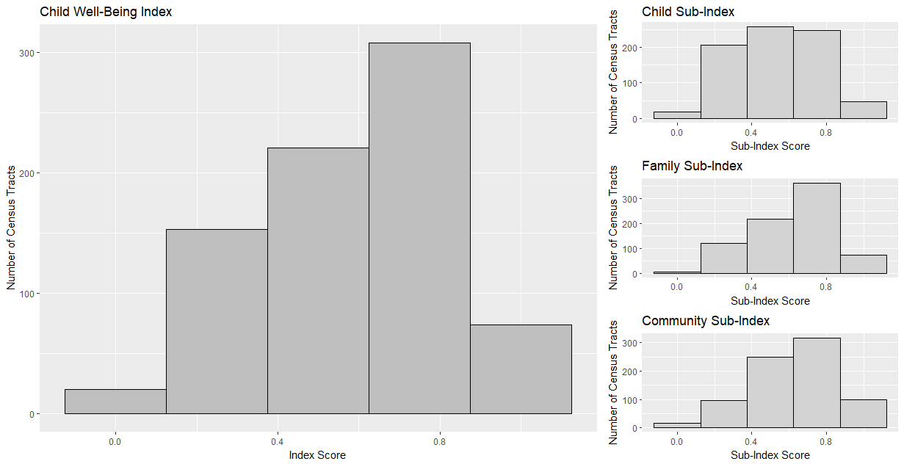
Results: Barplots

Slide 6
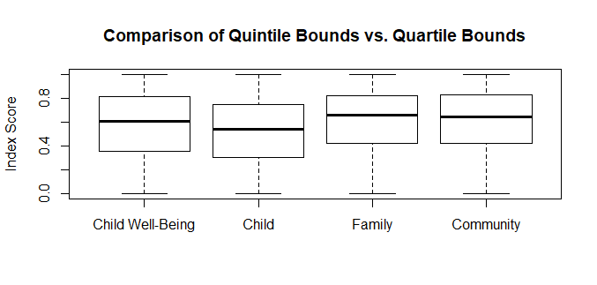
Results: Box-Plots
Notes:
These were not effective

Slide 7
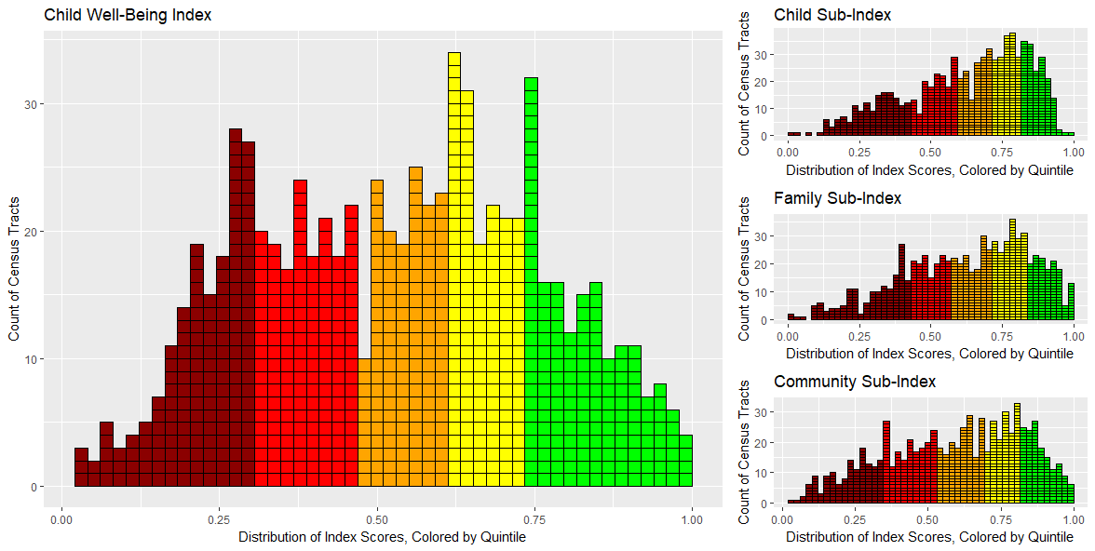
Results: Histogram Plot

Slide 8
Results: Histogram Plot

Slide 9
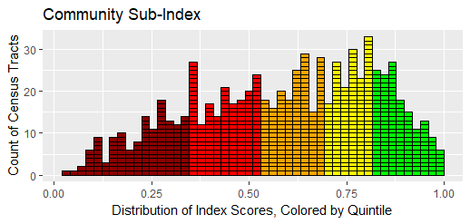
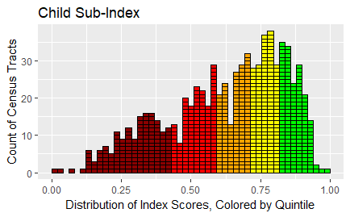
Results: SUB-indices
Community Sub-index
Child Sub-index

Slide 10
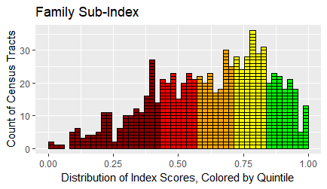
Results: SUB-indices
Community Sub-index
Family Sub-index

Slide 11
Future Exploration
In this analysis we had to correct an error how we calculated Z-scores,
If united way work like us to continue making the forio app then we can

Slide 12
CONTACT TO HELP WITH research
Contacts:
https://github.com/jonstoked/ChildWellBeing
https://github.com/ashtondrew/ChildhoodHunger
https://kdvdecisionanalysis.shinyapps.io/TODD_UWhunger/
Hackathon source: https://ncdata4good.github.io/UWchallenge/

Slide 13
Future Exploration
Explore Boundaries
Add to the meeting….
After the call, we put our heads together to figure out how we could reduce the degrees of freedom. We came up with a solution for putting “boundaries” on the possible values that I hope you will like- I’ve written up our proposal in the attached word document. Essentially, we’re proposing to change each indicator by its value rather than percent change. In addition, we’re suggesting putting “boundaries” on the value of each indicator and using nationwide county level data to help us determine what those “boundaries” should be. I’ve also attached an excel document with the initial boundary research that Deepa and I have done. Please note that 3 of the 5 indicators we researched do not yet have nationwide county level data- Deepa plans to continue her research next week.

